Slide 1



ata
Wizards
Members:-
Bhairavi Brahme (bkb6542@mavs.uta.edu)
Mehul Hivlekar (mxh6380@mavs.uta.edu)
Sakshi Deshmukh (sxd5431@mavs.uta.edu)
Sumit De (sxd0218@mavs.uta.edu)
Tejesh Rambothu (txr2671@mavs.uta.edu)

Slide 2




Problem Statement
In today's digital landscape, the abundance of online review platforms has led to a wealth of customer feedback. However, the manual analysis of these reviews is time-consuming and often relies on rudimentary keyword matching. Our application aims to revolutionize this process by automating review analysis, providing actionable business insights from authentic customer feedback

Slide 3

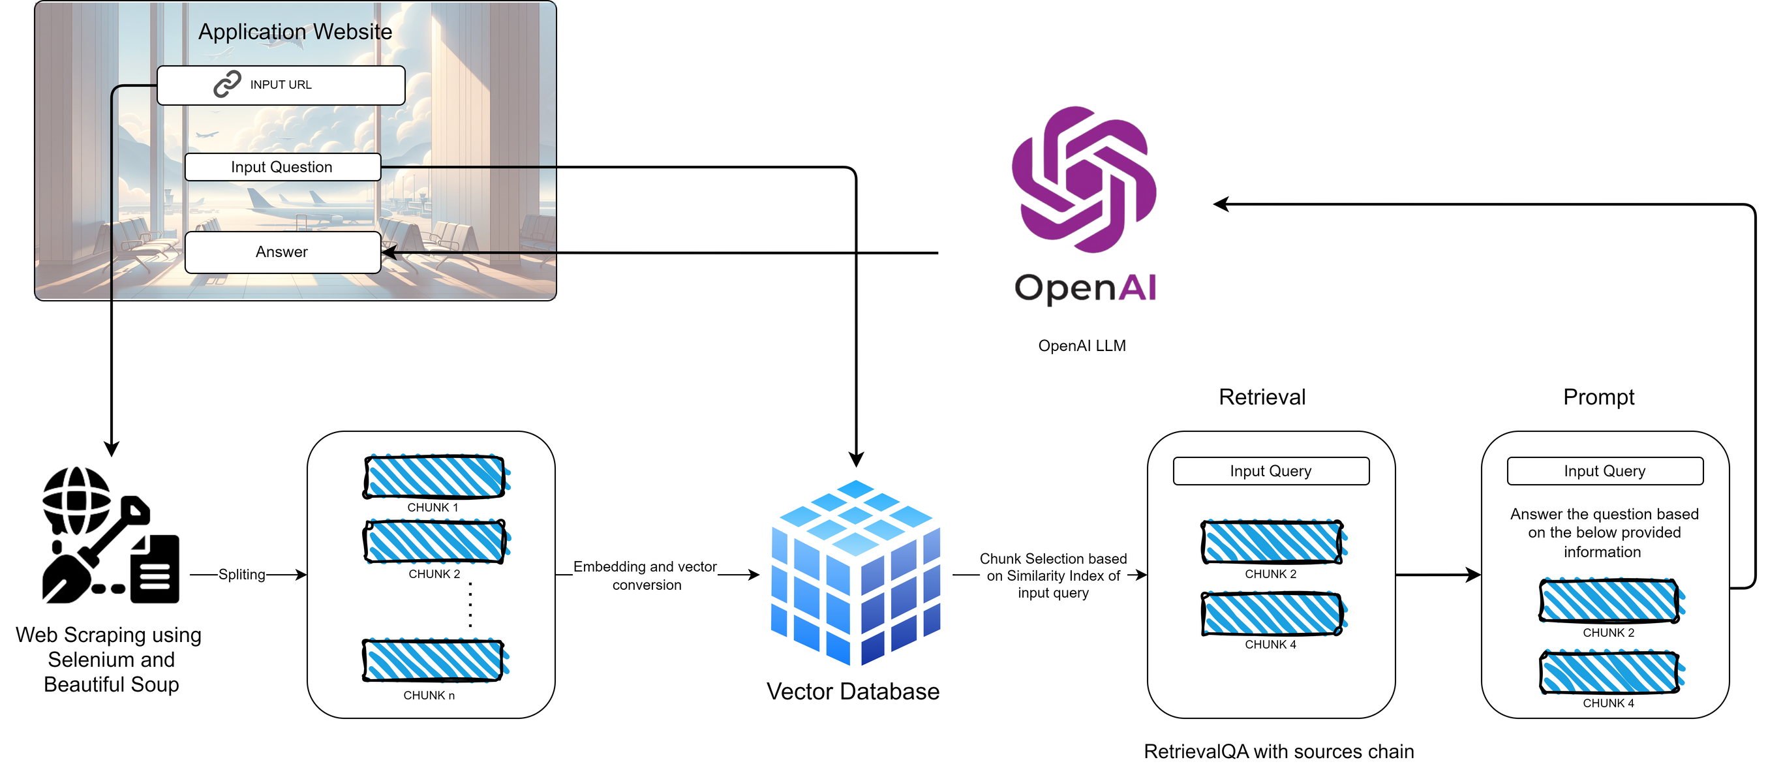
Solution

Slide 4






Operational Efficiency
Strategic Decision-Making
Business
Benefits
Cost Optimization
Scalable Solution

Slide 5
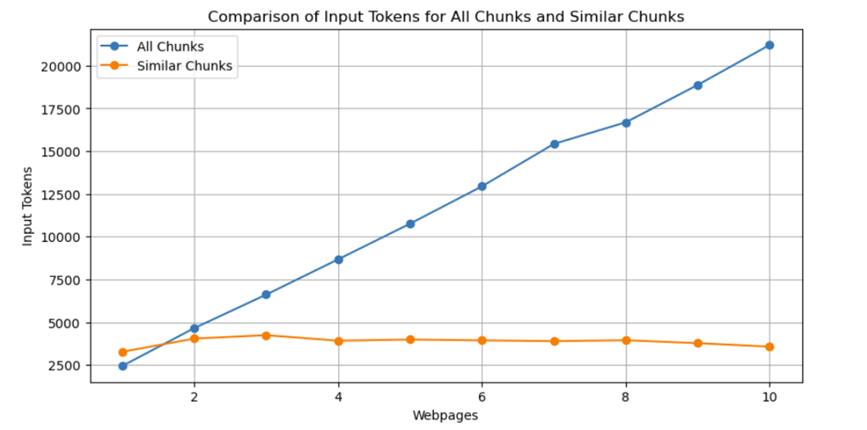
Optimization
At $0.5 per 1M input token & $1.5 per 1M output token the cost is significantly higher if all chunks are passed to the model.
Moreover 16385 is the maximum context length for GPT 3.5.
The contextual similarity between the two generated answers averages out at 0.9728.

Slide 6
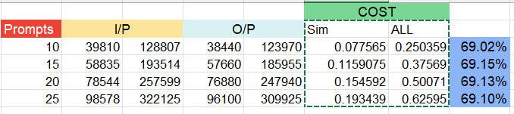
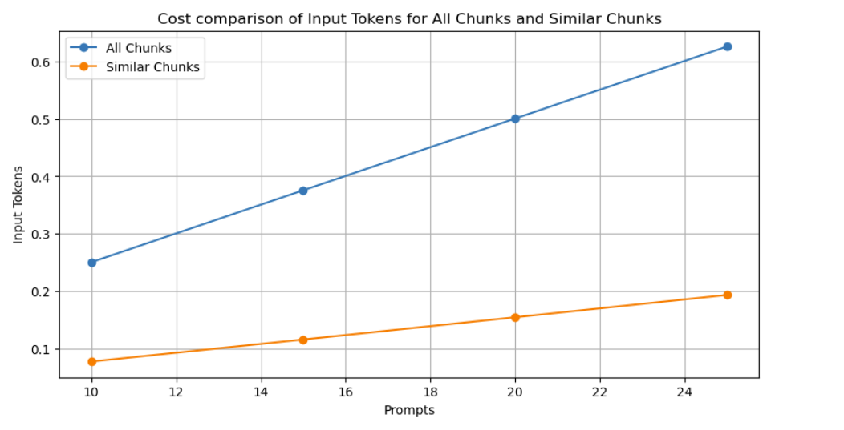
Optimization at Scale
Let's assume 20 users using application each prompting 25 times in a day
1 Year | 2 Years | 3 Years | 4 Years | 5 Years
78475 | 156950 | 235425 | 313900 | 392375
Cost difference for single iteration of 25 prompts is $0.4325

Slide 7



Production Challenges
Scaling infrastructure to sustain server performance under increased user load.
Accommodating review website changes
Adhering to data privacy regulations through encryption and secure storage.

Slide 8



Future Scope
Expanding the application beyond airport reviews to analyze feedback from other industries or domains.
Inclusion of other relevant metrics to analytic charts.
Exploration of other more robut Embedding and Similarity methods to optimise the process.

